Slide 1




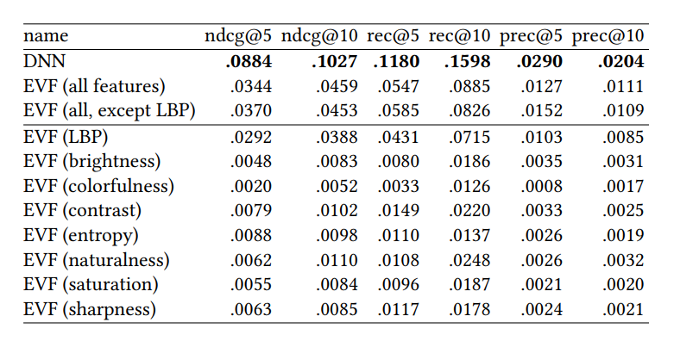
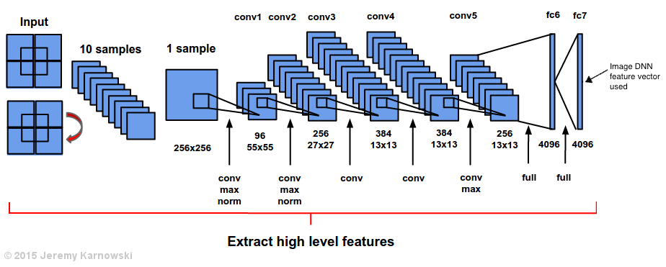
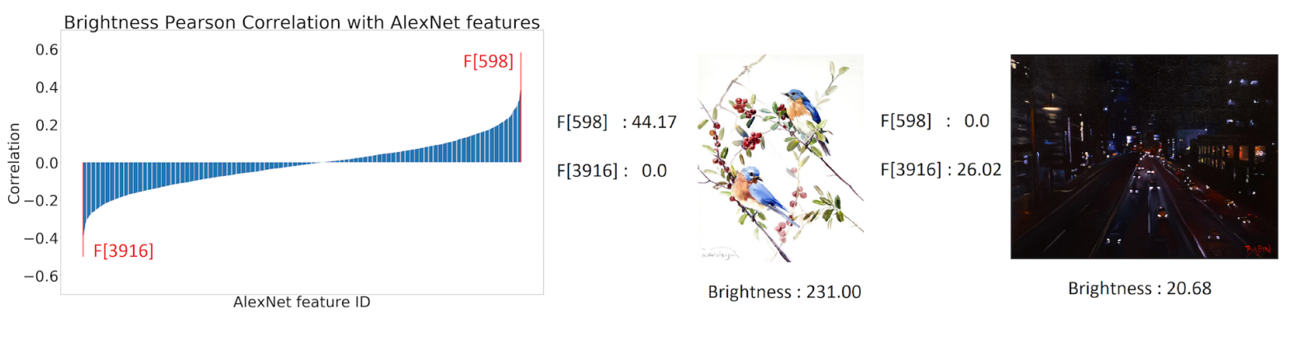
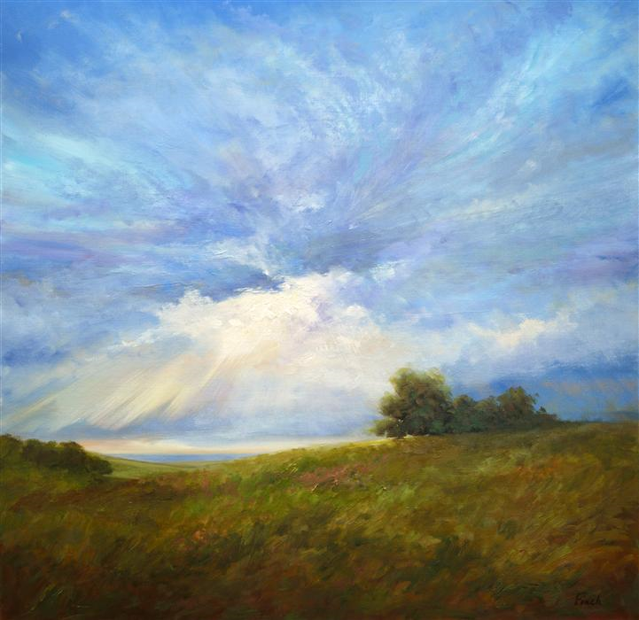
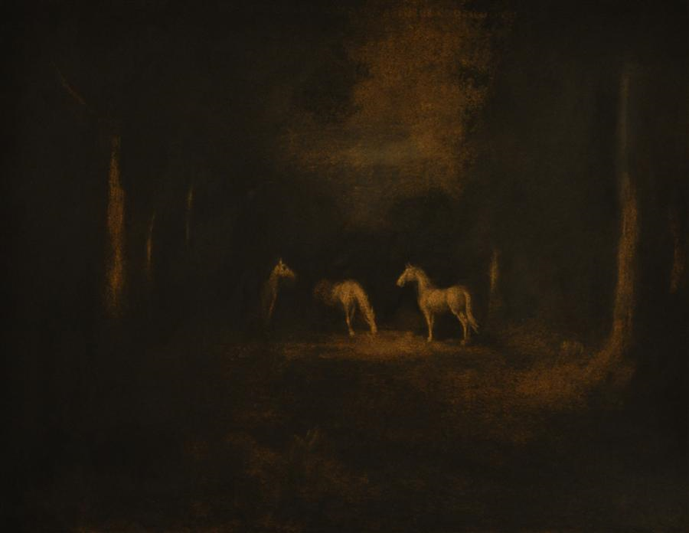
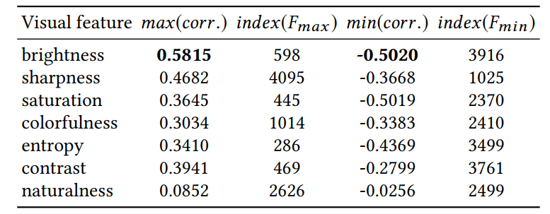
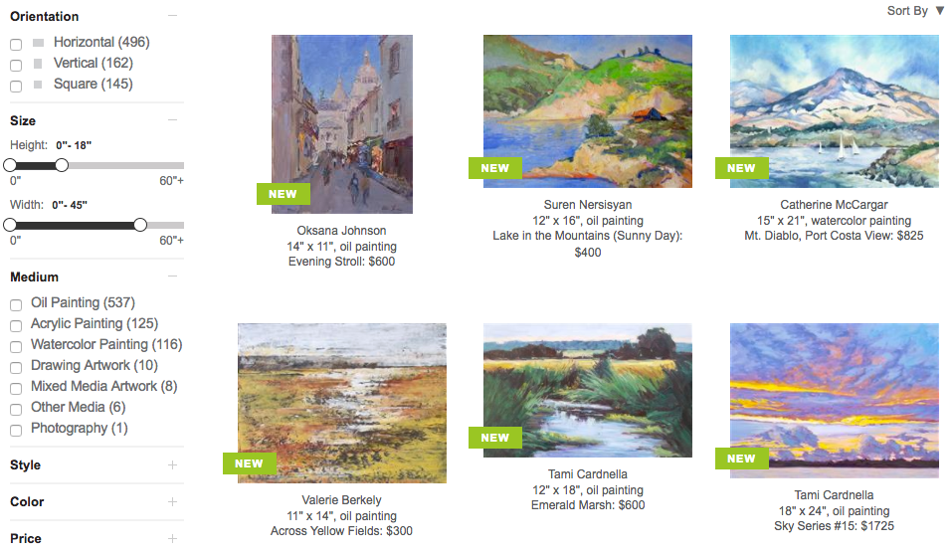
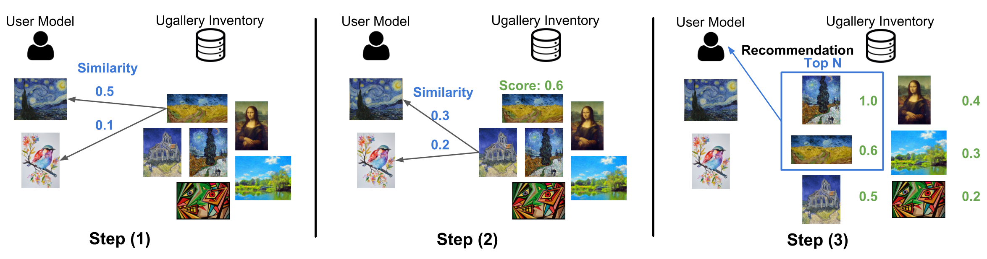
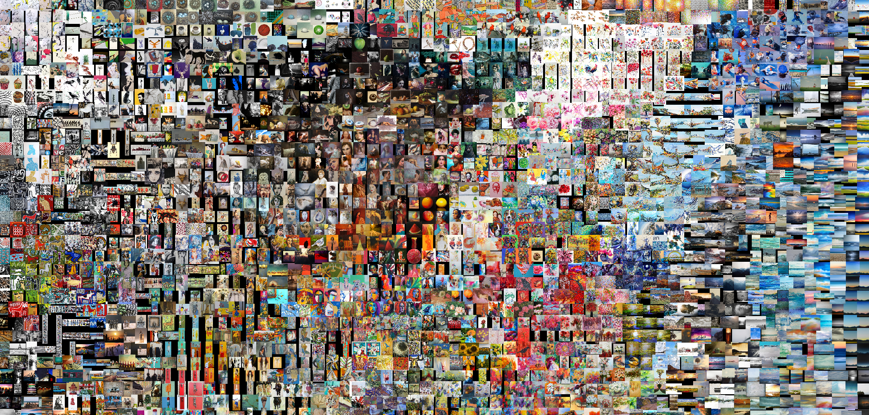
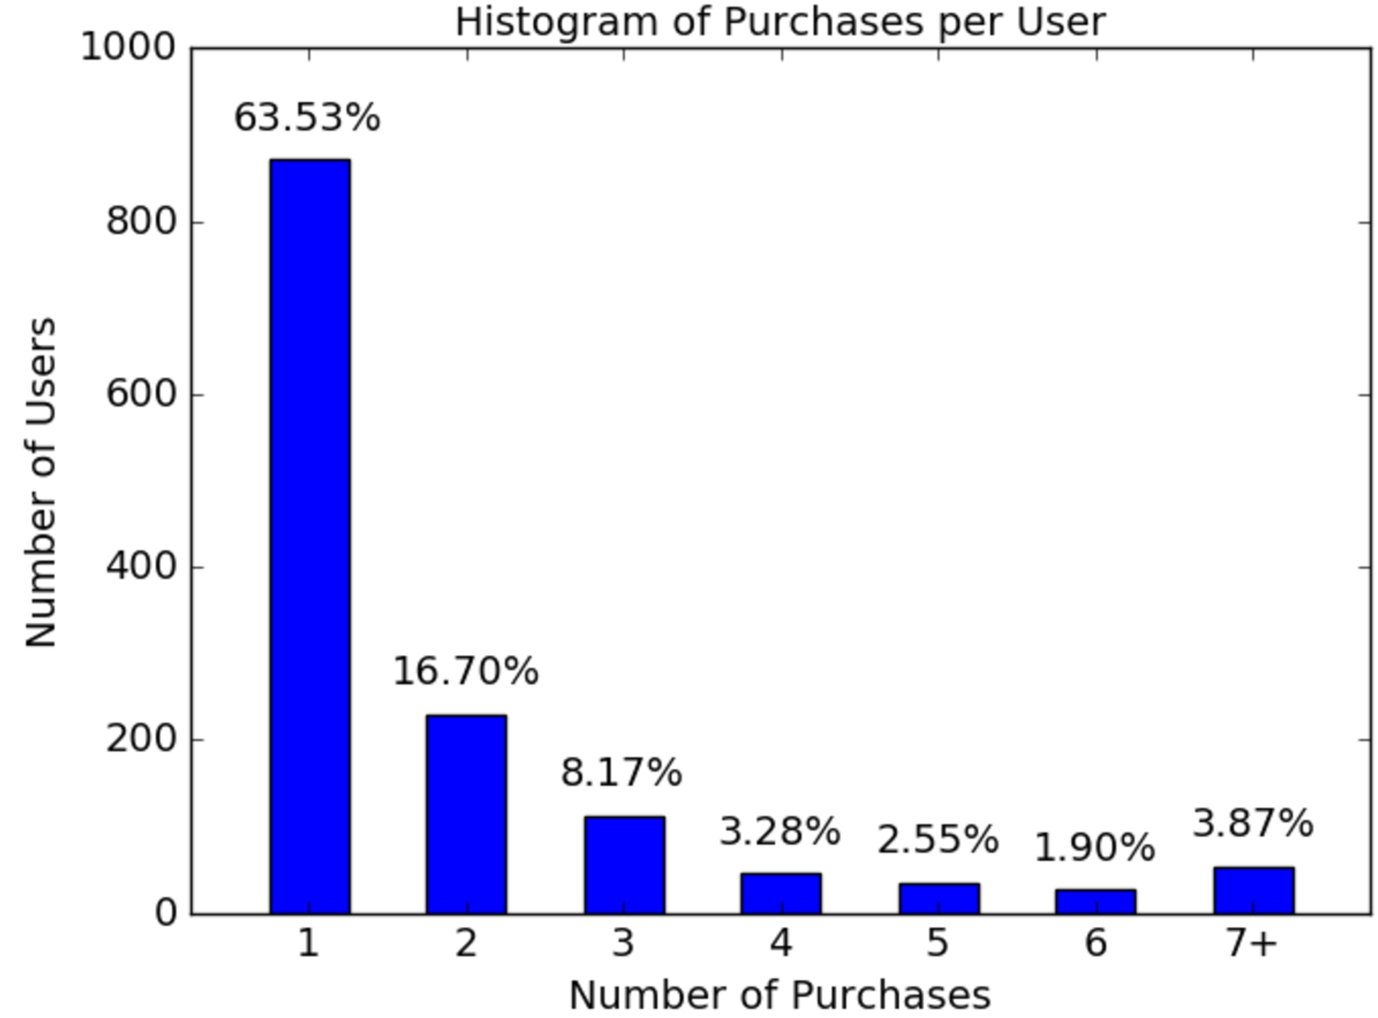
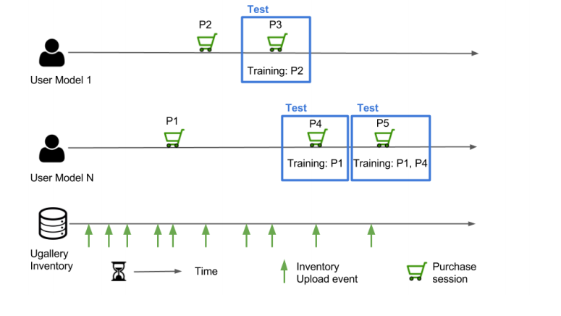
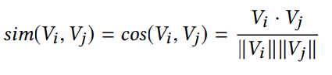
Comparing Neural and Attractiveness-based Visual Features for Artwork Recommendation
Vicente Dominguez, Pablo Messina, Denis Parra, Domingo Mery, Christoph Trattner, Alvaro Soto
Department of Computer Science, Pontificia Universidad Católica de Chile, Av. Vicuña Mackenna 4860, Santiago, Chile
{vidominguez, pamessina}@uc.cl, {dparra, dmery, asoto}@ing.puc.cl, christoph.trattner@modul.ac.at
Motivation
Visual Features
Evaluation & Results
Artwork Recommendation is a domain that has received relatively little research attention compared to others.
Many artists and clients are using artwork e-commerces on the Internet for publishing, selling or purchasing artworks.
Clear potential for improving clients and artists’ user experience through development and application of recommender systems.
Deep Neural Networks (DNN): we used an AlexNet DNN (pre-trained with ImageNet ILSVRC 2012 dataset) to map each artwork image to its corresponding latent vector of 4,096 dimensions obtained at the fc6 layer of the AlexNet network.
Research Goals
Study the performance of personalized content-based artwork recommendations using 2 types of visual feature vectors:
Deep Neural Network (DNN) latent feature vectors.
Explicit Visual Feature (EVF) vectors.
Do an exploratory correlation analysis between DNN and EVF features to find out possible strong correlations that could be used for explainability of DNN-based recommendations.
Results of the recommendation task using a diverse set of latent (DNN) and explicit visual features (EVF)
Feature Correlation Analysis
Explicit Visual Features (EVF): for each artwork image we extracted multiple handcrafted features, including:
Attractiveness features, obtained with the OpenCV library:
Brightness
Saturation
Sharpness
Colorfulness
Naturalness
RGB-contrast
Entropy
LBP: Local Binary Patterns [16] , obtained using the Matlab Library Balu.
UGallery
At the left, an artwork with a high value of Colorfulness (197.46). At the right one with a low value (16.18).
The plot at the left shows the correlation of each AlexNet feature with the visual feature Brightness, highlighting features with most negative (F[3916] = −.5) and positive correlations (F [598] = .58).
UGallery is a web e-commerce for one-of-a-kind physical artworks.
Recommendation Approach
Maximum and minimum correlation between attractiveness-based visual features and the 4,096 AlexNet embeddings, indicating the respective dimension index.
Partial t-SNE map of the Ugallery dataset using the image embeddings from AlexNet DNN. This map helps to show groups of similar images as encoded with the AlexNet embedding. The grid is made using Jonker-Volgenant algorithm [7].
Dataset & Evaluation
For every item in the current inventory we: (1) calculate its similarity to each item in the user’s model, then (2) these single similarities are aggregated into a single score as either the sum or the maximum of all these similarities, and finally (3) the items are sorted by their scores and the top k items in the list are recommended.
Conclusion and Future Work
The similarity function used was cosine similarity
Conclusions:
DNN features performed better than EVF features (doubling the latter’s best performance), probably because AlexNet is able to capture more complex, abstract patterns.
LBP feature vector outperformed each attractiveness feature when used individually.
Attractiveness features outperformed LBP when they are all used together.
Combining LBP and attractiveness features in a single vector did not bring significant improvements on the recommender’s accuracy compared to attractiveness features alone.
There are a few noticeable correlations between some EVF and DNN features, but they are nowhere near conclusive. Further study would be necessary if we want to rule out this possibility.
Future Work:
Instead of using cosine similarity, we could approach the problem as a binary classification and learn user models with a logistic regression, optimizing for either learning-to-rate or learning-to-rank (e.g. BPR).
Try out new, more sophisticated pre-trained DNNs, such as GoogleLeNet.
Explore other ways to explain DNN-based artwork recommendations.
Conduct online user studies to validate offline results.
References
[1] LM Aroyo, Y Wang, R Brussee, Peter Gorgels, LW Rutledge, and N Stash. 2007. Personalized museum experience: The Rijksmuseum use case. In Proceedings of Museums and the Web.
[2] Paolo Cremonesi, Yehuda Koren, and Roberto Turrin. 2010. Performance of Recommender Algorithms on Top-n Recommendation Tasks. In Proceedings of the Fourth ACM Conference on Recommender Systems (RecSys ’10). ACM, New York, NY, USA, 39–46.
[3] Yashar Deldjoo, Massimo Quadrana, Mehdi Elahi, and Paolo Cremonesi. 2017. Using Mise-En-Scene Visual Features based on MPEG-7 and Deep Learning for Movie Recommendation. (2017). arXiv:arXiv:1704.06109
[4] Ruining He, Chen Fang, Zhaowen Wang, and Julian McAuley. 2016. Vista: A Visually, Socially, and Temporally-aware Model for Artistic Recommendation. In Proceedings of the 10th ACM Conference on Recommender Systems (RecSys ’16). ACM, New York, NY, USA, 309–316. https://doi.org/10.1145/2959100.2959152
[5] Ruining He and Julian McAuley. 2016. VBPR: visual Bayesian Personalized Ranking from implicit feedback. In Proceedings of the Thirtieth AAAI Conference on Artificial Intelligence. AAAI Press, 144–150.
[6] Yangqing Jia, Evan Shelhamer, Jeff Donahue, Sergey Karayev, Jonathan Long, Ross Girshick, Sergio Guadarrama, and Trevor Darrell. 2014. Caffe: Convolutional Architecture for Fast Feature Embedding. arXiv preprint arXiv:1408.5093 (2014).
[7] Roy Jonker and Anton Volgenant. 1987. A shortest augmenting path algorithm for dense and sparse linear assignment problems. Computing 38, 4 (1987), 325–340.
[8] Joseph A Konstan and John Riedl. 2012. Recommender systems: from algorithms to user experience. User Modeling and User-Adapted Interaction 22, 1-2 (2012), 101–123.
[9] Alex Krizhevsky, Ilya Sutskever, and Geoffrey E Hinton. 2012. Imagenet classification with deep convolutional neural networks. In Advances in neural information processing systems. 1097–1105.
[10] Laurens van der Maaten and Geoffrey Hinton. 2008. Visualizing data using t-SNE. Journal of Machine Learning Research 9, Nov (2008), 2579–2605.
[11] Augusto Q Macedo, Leandro B Marinho, and Rodrygo LT Santos. 2015. Contextaware event recommendation in event-based social networks. In Proceedings of the 9th ACM Conference on Recommender Systems. ACM, 123–130.
[12] Christopher D Manning, Prabhakar Raghavan, Hinrich Schütze, et al. 2008. Introduction to information retrieval. Vol. 1. Cambridge university press Cambridge.
[13] Julian McAuley, Christopher Targett, Qinfeng Shi, and Anton Van Den Hengel. 2015. Image-based recommendations on styles and substitutes. In Proceedings of the 38th International ACM SIGIR Conference on Research and Development in Information Retrieval. ACM, 43–52.
[14] Pablo Messina, Vicente Dominguez, Denis Parra, Christoph Trattner, and Alvaro Soto. 2017. Exploring Content-based Artwork Recommendation with Metadata and Visual Features. arXiv preprint arXiv:1706.05786 (2017).
[15] Anh Nguyen, Jason Yosinski, and Jeff Clune. 2016. Multifaceted feature visualization: Uncovering the different types of features learned by each neuron in deep neural networks. arXiv preprint arXiv:1602.03616 (2016).
[16] Timo Ojala, Matti Pietikäinen, and David Harwood. 1996. A comparative study of texture measures with classification based on featured distributions. Pattern recognition 29, 1 (1996), 51–59.
[17] Jose San Pedro and Stefan Siersdorfer. 2009. Ranking and Classifying Attractiveness of Photos in Folksonomies. In Proceedings of the 18th International Conference on World Wide Web (WWW ’09). ACM, New York, NY, USA, 771–780.
[18] Ali Sharif Razavian, Hossein Azizpour, Josephine Sullivan, and Stefan Carlsson. 2014. CNN features off-the-shelf: an astounding baseline for recognition. In Proceedings of the IEEE Conference on Computer Vision and Pattern Recognition Workshops. 806–813.
[19] Karen Simonyan and Andrew Zisserman. 2014. Very deep convolutional networks for large-scale image recognition. arXiv preprint arXiv:1409.1556 (2014).
[20] Christian Szegedy, Wei Liu, Yangqing Jia, Pierre Sermanet, Scott Reed, Dragomir Anguelov, Dumitru Erhan, Vincent Vanhoucke, and Andrew Rabinovich. 2015. Going deeper with convolutions. In Proceedings of the IEEE Conference on Computer Vision and Pattern Recognition. 1–9.
[21] Katrien Verbert, Denis Parra, Peter Brusilovsky, and Erik Duval. 2013. Visualizing recommendations to support exploration, transparency and controllability. In Proceedings of the 2013 international conference on Intelligent user interfaces. ACM, 351–362.
[22] Deborah Weinswig. 2016. Art Market Cooling, But Online Sales Booming. https://www.forbes.com/sites/deborahweinswig/2016/05/13/art-market-cooling-but-online-sales-booming/. (2016). [Online; accessed 21-March-2017].
[23] Matthew D Zeiler and Rob Fergus. 2014. Visualizing and understanding convolutional networks. In European conference on computer vision. Springer, 818–833.
UGallery shared with us an anonymized dataset of 1, 371 users, 3, 490 paintings (with their respective images) and 2, 846 purchases (transactions) of paintings, where all users have made at least one transaction. On average, each user has bought 2-3 items in the latest years.
We evaluate the recommender algorithms in a time-based manner. We simulate upload and purchase session events through time following the events’ timestamps. At any purchase session event, we generate a personalized recommendation to the active user based on his history of purchased artworks and test it against the artworks actually purchased during the current session.

